Slide 1
Assignment for Chapter 2
GROUP 7
1. Nguyễn Ngọc Mỹ Phương -BEBEIU22114
2. Phạm Thái Nhật Thanh-BEBEIU22133
3. Nguyễn Thị Như Quỳnh-BEBEIU22122
4. Đặng Thị Trúc Thắm - BEBEIU22132
5. Đặng Trần Minh Châu - BEBEIU22019
6. Nguyễn Ngọc Phương Thảo - BEBEIU22135
7. Lê Đức Toản - EEEEIU22065
8. Đỗ Minh Duy - ITITSB22029

Slide 2
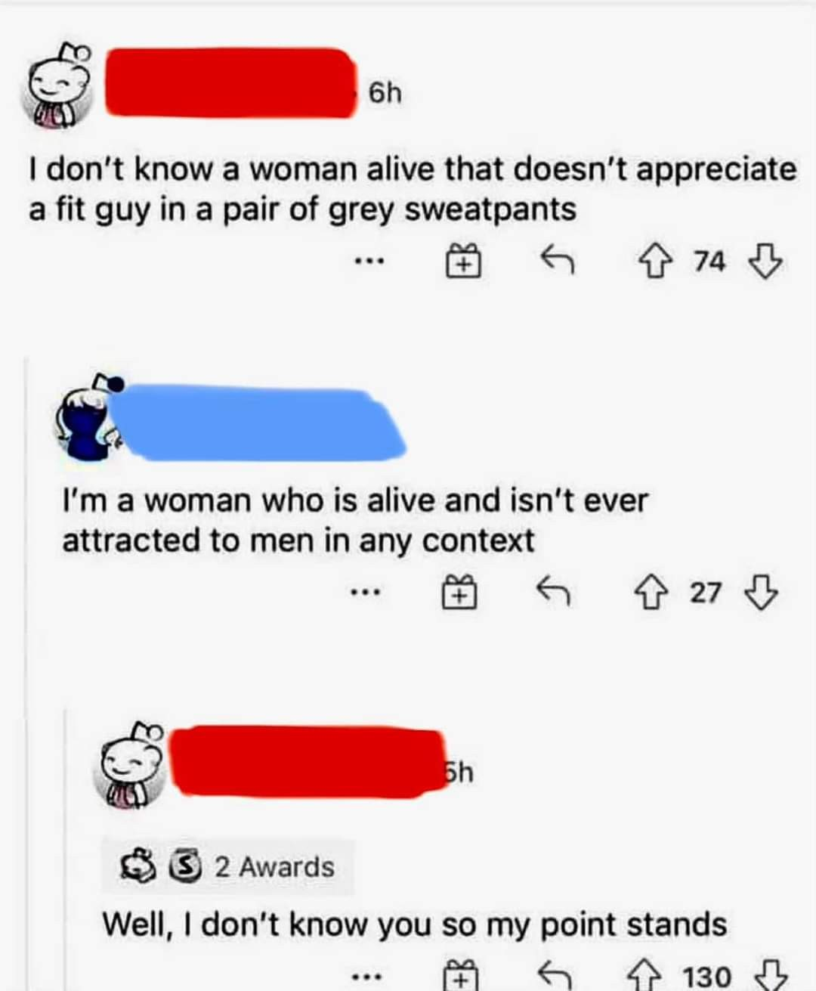
Task 1: Identify each text. If there is an argument, find the premise, conclusion and assumption
Yes, there is an argument,
Premise 1: the man in the chat box does not know any woman who is alive and does not appreciate a fit guy in a pair of grey sweatpants.
Premise 2: There is a woman said to him that she is a woman who is alive and does not attract men in any context.
Conclusion: He does not know the woman above so his point stands.
Assumption: Because he does not know the woman who replies to his opinion, he believes that his opinion is true.

Slide 3

Task 2: Is the speaker’s text an argument? If not, rewrite it in the form of an argument.
No, it is not an argument because it is a conditional sentence.
Rewrite :
Premise: If the kid born to inherit your poverty and hard work => If you do not have enough financial conditions.
Conclusion: Then not birthing the kid is also the kind of goodness => Then you should prepare carefully so as not to cause the child to suffer deprivation when borned.
=> If you do not have enough financial conditions,then you should prepare carefully so as not to cause the child to suffer deprivation when borned.

Slide 4
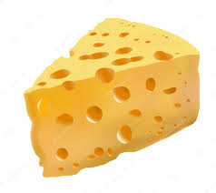
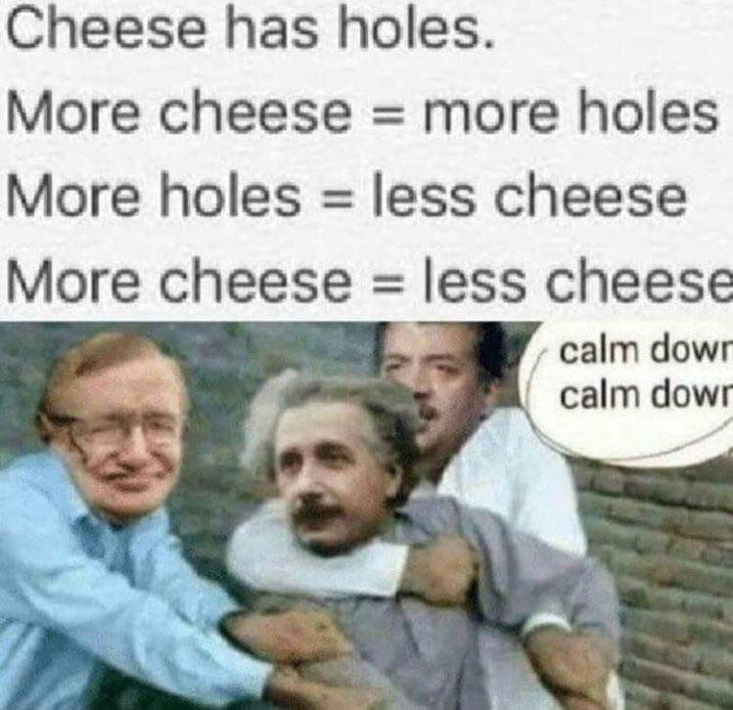
Task 3: Indicate the premises and the conclusion. Then identify the assumption to agree or disagree with the conclusion.
Premises: cheese has holes, more cheese means more holes, more holes means less cheese.
The conclusion: more cheese = less cheese.
Disagree: The problem is that the second statement, "More cheese means more holes," is ambiguous. It depends on how we define "more cheese." If we mean a larger block of cheese with the same proportion of holes, then yes, there will be more holes. But if we mean a larger block of cheese with the same amount of cheese (i.e., the hole proportion shrinks as the cheese gets bigger), then no, there won't be more holes. The amount of cheese can increase while the proportion of holes stays the same or even decreases.

Slide 5
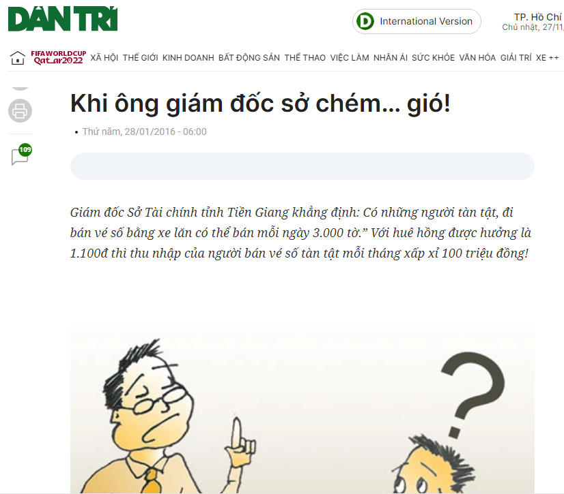
Task 4: Rephrase the Director’s argument’s argument and identify his assumption.
Rephrase: According to the director, since each ticket sells for 1100 VND commission and 3,000 tickets are sold every day, the profit made by those with disabilities from lottery sales might reach up to 100 million VND.
The fact: One lottery ticket might yield a commission of 1100 VND.
Opinion: It is possible for disabled people to sell 3,000 lottery tickets in one day.
Conclusion: People with disabilities using wheelchairs can earn 100 million each month.
=> Assumption: The condition is that people are disabled, sell lottery tickets each day of the month and sell 3000 tickets in one day.
Notes:
https://dantri.com.vn/dien-dan/khi-ong-giam-doc-so-chem-gio-20160126214551159.htm

Slide 6
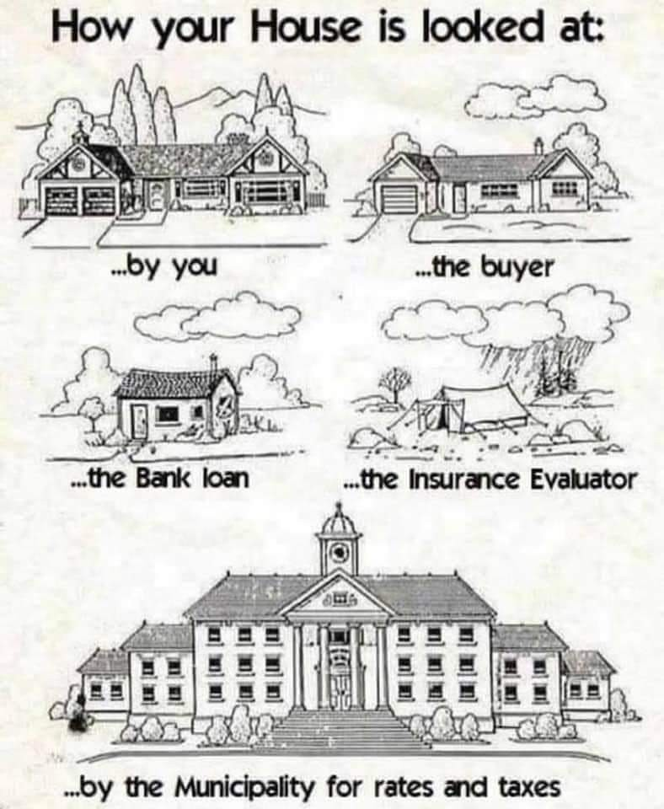
Task 5: Make an argument out of the meme.
Argument:
As the owner, you have a personal connection to your house. You see it as a home, a place filled with memories and emotions. Your perspective is often influenced by the comfort, aesthetics, and functionality it provides for you and your family.
As the Buyers, potential buyers approach your house with a critical eye. They evaluate its condition, location, and amenities to determine its value and suitability for their needs. They may consider factors such as the layout, size, maintenance requirements, and potential for future renovations. So, the house can be priced exactly as buyers want.
As the Bank loan, when evaluating your house for a loan, banks consider its market value, as it serves as collateral. Appraisers assess the property to determine its worth, taking into account factors such as location, condition, comparable sales in the area, and potential market trends. Banks focus on the property's potential for resale and its ability to secure the loan.
As insurance evaluators, they assess your house from a risk perspective. They consider potential hazards, such as natural disasters, accidents, or theft, and estimate the likelihood and cost of potential claims. Factors such as the house's location, construction materials, security measures, and previous claims history may be taken into account.
As the local municipality evaluates your house to determine property taxes and rates. They typically assess its value based on factors such as location, size, condition, and amenities. This valuation helps determine the amount you need to pay in taxes and rates to support local services and infrastructure.

Slide 7
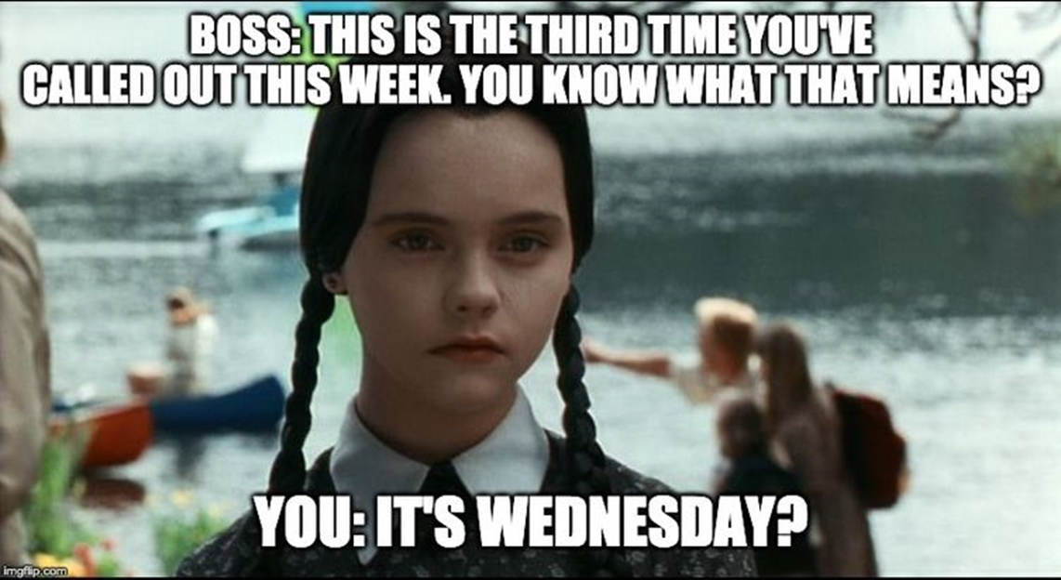
Task 6: Provide your meme and make an argument. Identify the premise(s), conclusion, and asumption(s).
a)
Premise: “This is the third time you’ve called out this week.” Boss said.
Conclusion: “It’s Wednesday?” employee said.
Assumption: The boss assumes that calling out three times in a week is a significant issue, possibly leading to some consequences. However, the employee are making a joke about the boss’s reaction and saying that Wednesday is a middle of week or an arbitrary day to address frequent absences.
Source: https://powertofly.com/up/funny-boss-memes

Slide 8
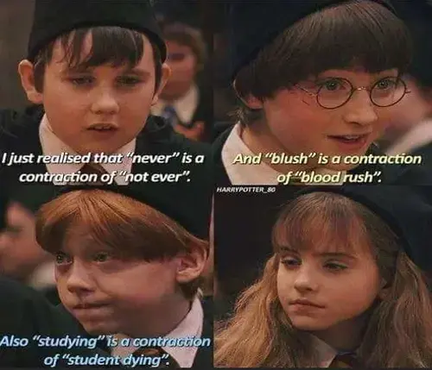
Task 6: Provide your meme and make an argument. Identify the premise(s), conclusion, and assumption(s).
b)
Premise 1: “never” is a contraction of “ not ever” Neville said.
Premise 2: “blush” is a contraction of “blood rush” Harry said.
Conclusion: “studying” is a contraction of “ student dying” Ron said.
Assumption: Abbreviations in English follow the same rule.
Source:https://medium.com/@chameleonmemes46/25-hilarious-memes-that-prove-english-is-the-funniest-language-587d86d8f18b

Slide 9


